Slide 1
Cedar Falls K-12
Science Adoption
Board Presentation:
Kelly Cota, Associate Director of Curriculum and Instruction
Amy Kohlhaas, Elementary Curriculum and Professional Development Lead
Sarah Cooper, Secondary Curriculum and Professional Development Lead
Brian Unruh, Associate Director of Instructional Technology
Notes:
Kelly introduce
Slides 1-2 Kelly
Slides 3-5 Sarah
Slides 4-6 Amy
Slide 7+: Kelly

Slide 2

Agenda
  Timeline
  Developing a Vision
  Science Committee
  Iowa Science Standards
  Communication and Feedback
  Final Selection of Instructional Resources
  Professional Learning
  Implementation Plan
Notes:
Kelly introduce
We plan to share with you this evening our process built on solid research-based practices, transparency, and teacher voice.

Slide 3
Cedar Falls K-12 Science Curriculum Adoption
Create Committee, Look at Current Reality and Vision
Professional Learning, Deep Study of Materials
Professional Learning aligned to Materials
Full Adoption
Spring/Fall 2024
Current Reality & Vision
Fall/
Winter
2024
Fall/
Winter
Materials
Exploration
Spring
2025
Selection of Materials
Fall 2025
Implementation & Continued Professional Learning
Notes:
Sarah
Review timeline and where we are

Slide 4
Cedar Falls Science Vision Statement
"Our vision for science instruction in Cedar Falls is to…
deliver an engaging, standards-driven experience that prepares students for the future. Through hands-on learning, inquiry, and collaboration, we will inspire critical thinkers and problem-solvers equipped with real-world skills to make a meaningful impact on our community."
Notes:
Sarah
Concise overview of how we did this work
Table groups discussing what we want for science instruction in Cedar Falls-consolidation of multiple ideas into one

Slide 5
Cedar Falls Science Team Promise
As a member of this team and a representative of the educators I serve, I will use this rubric to ensure that the materials align with high-quality instructional practices, are grounded in evidence-based NGSS (Iowa Standards), and promote equitable learning opportunities for all students. I will remain objective, free of bias, and open to diverse viewpoints, evaluating the materials through the lens of accuracy, inclusivity, and relevance to the needs of all learners. My goal is to support a science education that advances the
Cedar Falls Vision for Science.
Notes:
Amy
Promise driven from vision

Slide 6

The Science Committee
Secondary
Secondary Principal Secondary Science Dept chairs Secondary Special Education Secondary Instructional Coach | Jason Wedgbury - Andy Beland, Lynn Griffin, Amanda Johnson, Jared Pirkl, Melisa Reilly, Jen Schultz, Rob Welter, Alicia Wrage, Kimberly Willmert
Elementary
Elementary Principal Elementary Building Representation (teachers) Elementary Grade Level Representation (teachers) Elementary Instructional Coach | Jaymie Odell - Lexi Brown, Jane Cline, Tonia Ferguson, Sarah Gould, Laura Kats, Sherri Larson, Jamie Moody, Kelly Pirkl, Staci Wilkinson
Notes:
Amy

Slide 7

Iowa Science Standards
Standard Revision
  Cedar Falls Representation - Kimberly Wilmert (HS Biology)
  Proposal sent for Community feedback
  Final Decision: Late April
Standard Coherence
  Educators have the flexibility to arrange the standards in any order within a grade level/band to suit the needs of students and science programs.
Programming Consideration
  All standards are intended for all students so districts need to consider how this expectation might impact high school scope and sequence.
Notes:
Kelly

Slide 8
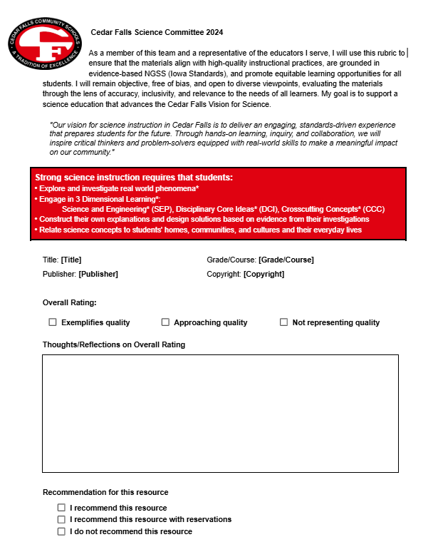

Data and Decision
Evidence-based Options | Rubric/Criteria | Final Selection
Amplify Science Open Sci Ed Experience Science |  | Savvas
Notes:
Kelly

Slide 9



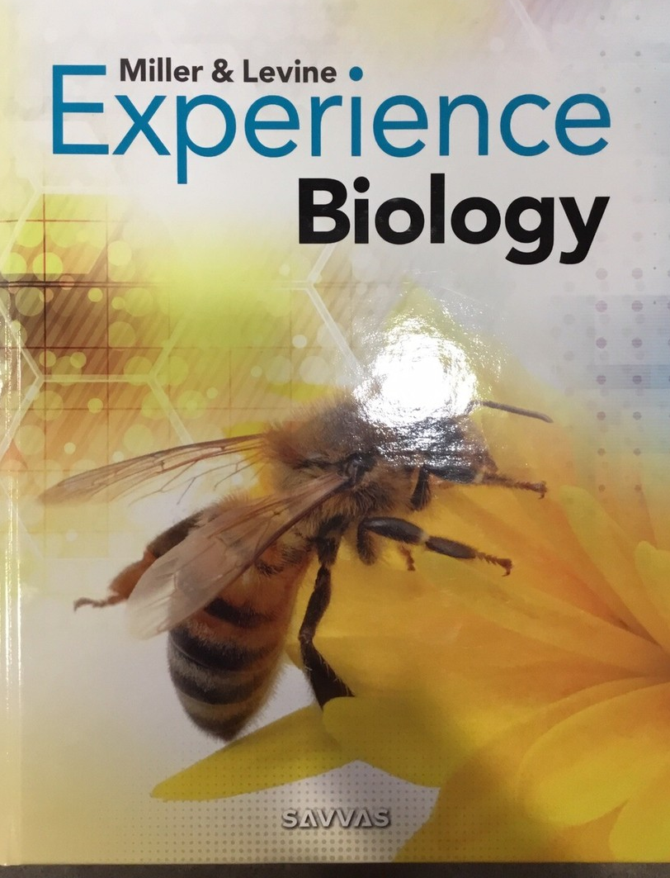

Savva Experience Science
K-8 Experience Science
Coming soon 🠊
Notes:
Kelly

Slide 10
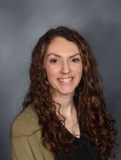
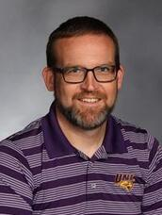
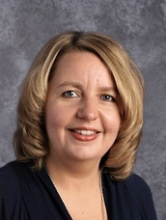
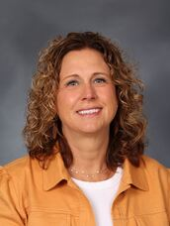
Standards Aligned Opportunities
3 Dimensional Learning - Voice and Choice - Durable Skills
Cross Content connections
Usability - share example from K experience
“The possibility of a coherent K–12 curriculum excites me because it creates a connected learning experience where each grade builds on the last, supporting deeper understanding and collaboration across grade levels. Last fall, I was part of a team that wrote the new Iowa Science Standards, which gave me valuable insight into how thoughtfully designed standards support long-term learning and that experience helped us better evaluate potential curricula for coherence, alignment, and student engagement. I'm especially excited about the real-world phenomena embedded within SAVVAS that can be used to spark curiosity and make science more meaningful for our students.” ~ Kimberly Willmert
Why did we select Savvas?
What excites you about Savvas Experience?
Notes:
Kelly introduce teachers to speak

Slide 11
Implement and Sustain
Learning for Leaders
  Onsite learning for Science team and coaches
  Content leaders and Dept. Chairs will support implementation
All-Staff Learning and Training
  Science: ½ day trainings in August on Science instructional practices (AEA)
  Savvas virtual Q and A fall session for Science leaders
  Elementary Science Content leaders will lead Workshop Wednesday sessions
  Dept. Chairs (learning with AEA and Savvas)
Soft Launch
  All elementary will teach and reflect on 1 unit this fall (cross content work)
  Secondary - collaborative planning to ensure coherence
Multi-year Learning
  Plan to support new (to CF) teachers
  Affordable and accessible learning offered in-person and onsite.
Notes:
Kelly

Slide 12
Questions?

Slide 13
Thank you!

