Slide 1
Excellence grants
Awarded November, 2018
Cedar Falls Schools Foundation

Slide 2
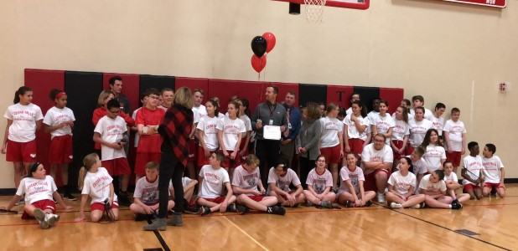
Ethan Jennings, peet jr. high
Rowing Machine
for Physical Education

Slide 3
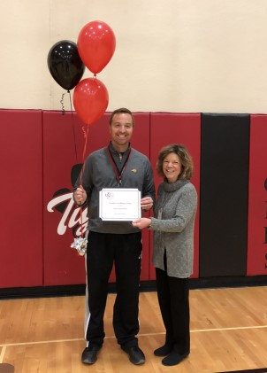
thirteen grants, sixty five teachers
Bolger | School-to-Home Book Connection | Jennifer Tjaden, Katie Charlton, Jessica Folkerts, Abbie Perez | First | Reading | Aldrich Elementary
Brenden | OSMOS Genuis Kits Purposeful Technology Integration | Traci Edson, Tami Halvorson, Vee Barnard | Kindergarten | Tech, Literacy, Math | Orchard Hill Elementary
Legacy of Learning | Short Reads for Great Gains | Jen McCartan, Stacy Gary, Angie Chambers | Third | English Lang. Arts | North Cedar Elementary
Slykhuis | Innovators and Makers Enhancements | Bridget Adams | 7th - 9th | Computer Science | Holmes Junior High
Foundation Donors | Rowing to Fitness | Ethan Jennings, Will Carter, Judy Samek, Jamie Smith | 7th - 9th | PE | Peet Junior High
Foundation Donors | Dyslexia-Specific Learning Supplies | Twenty-Nine Special Education Teachers | Kdg. - 12th | Special Ed Reading | All Elementary Schools
Foundation Donors | STEM Summer Camp for Women and Minorities | Maria Perez, Ethan Wiechmann, Megan Droste, Nate Clayberg, Alba Aguillon | 7th - 12th | STEM | Peet, Homes, Cedar Falls High School
Foundation Donors | Tiger Pride Garden Expansion | Robert Welter, Jim Duff, Maria Hoekstra, Amanda Johnson, Shelley Lauritsen, Erin Sliwinski | 7th - 9th | Science | Holmes Junior High
Foundation Donors | Tiger Talks for All Seventh Grade | Julie Rouse, Angela Wittmer, Heather Scannell | 7th | School Improvement | Holmes Junior High
Foundation Donors | Say and Play | Katie Kaddatz | Kdg. - 6th | Music | North Cedar Elementary
Foundation Donors | Dynamic Duino Hyperduino Mini Makerspace Kits | Angela Webb, Jeb Batterson | Fourth | STEM | Aldrich Elementary
Foundation Donors | Creative Drama to Improve Literacy | Linda Withers, Judith Evans, Sonya Kremer | Second | Literacy | Aldrich Elementary
Foundation Donors | Bringing Home the Best STEM Books | Michelle Kirchner, Jennifer Anderson, Leah Franklin, Erika Heider | First | Reading, STEM | Hansen Elementary

Slide 4
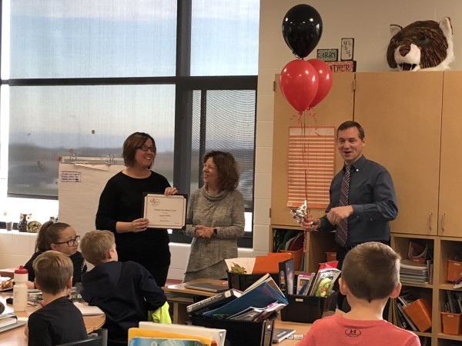
Angela webb, Jeb batterson, Aldrich elementary
Dynamic Duino
in STEM, 4th Grade

Slide 5
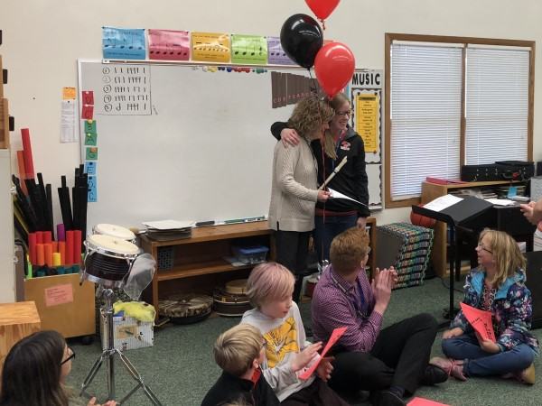
Katie kaddatz, north cedar elementary
Say and Play in Music

Slide 6
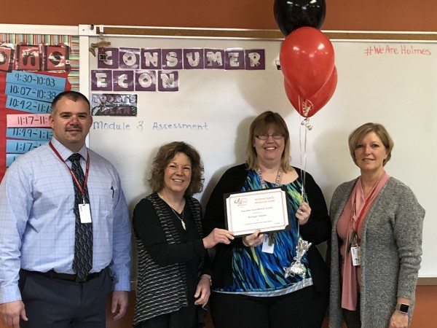
Bridget Adams, holmes jr. high
Slykhuis Family Memorial Excellence Grant
Innovators and Makers Enhancements in Computer Science

Slide 7
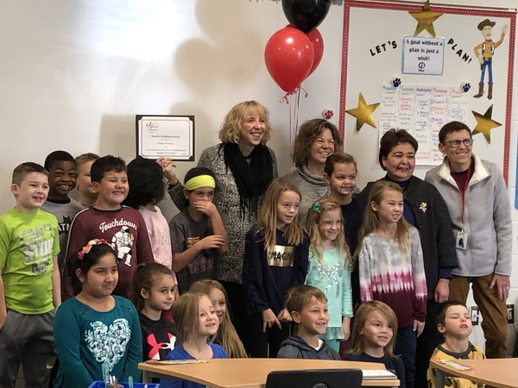
Linda withers, Aldrich elementary
Creative Drama to Improve Fluency, Comprehension and Confidence in 2nd Grade

Slide 8
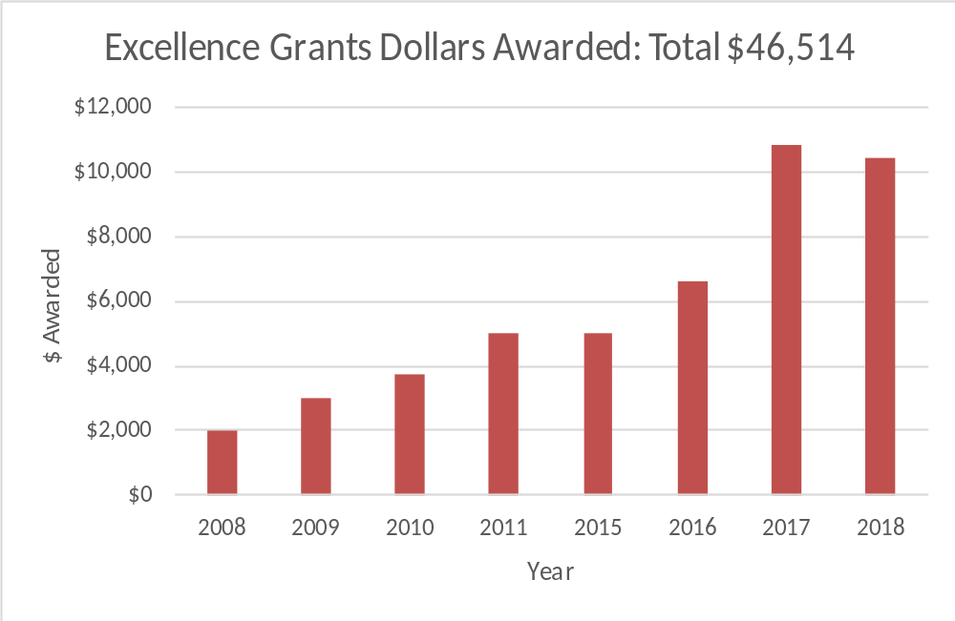
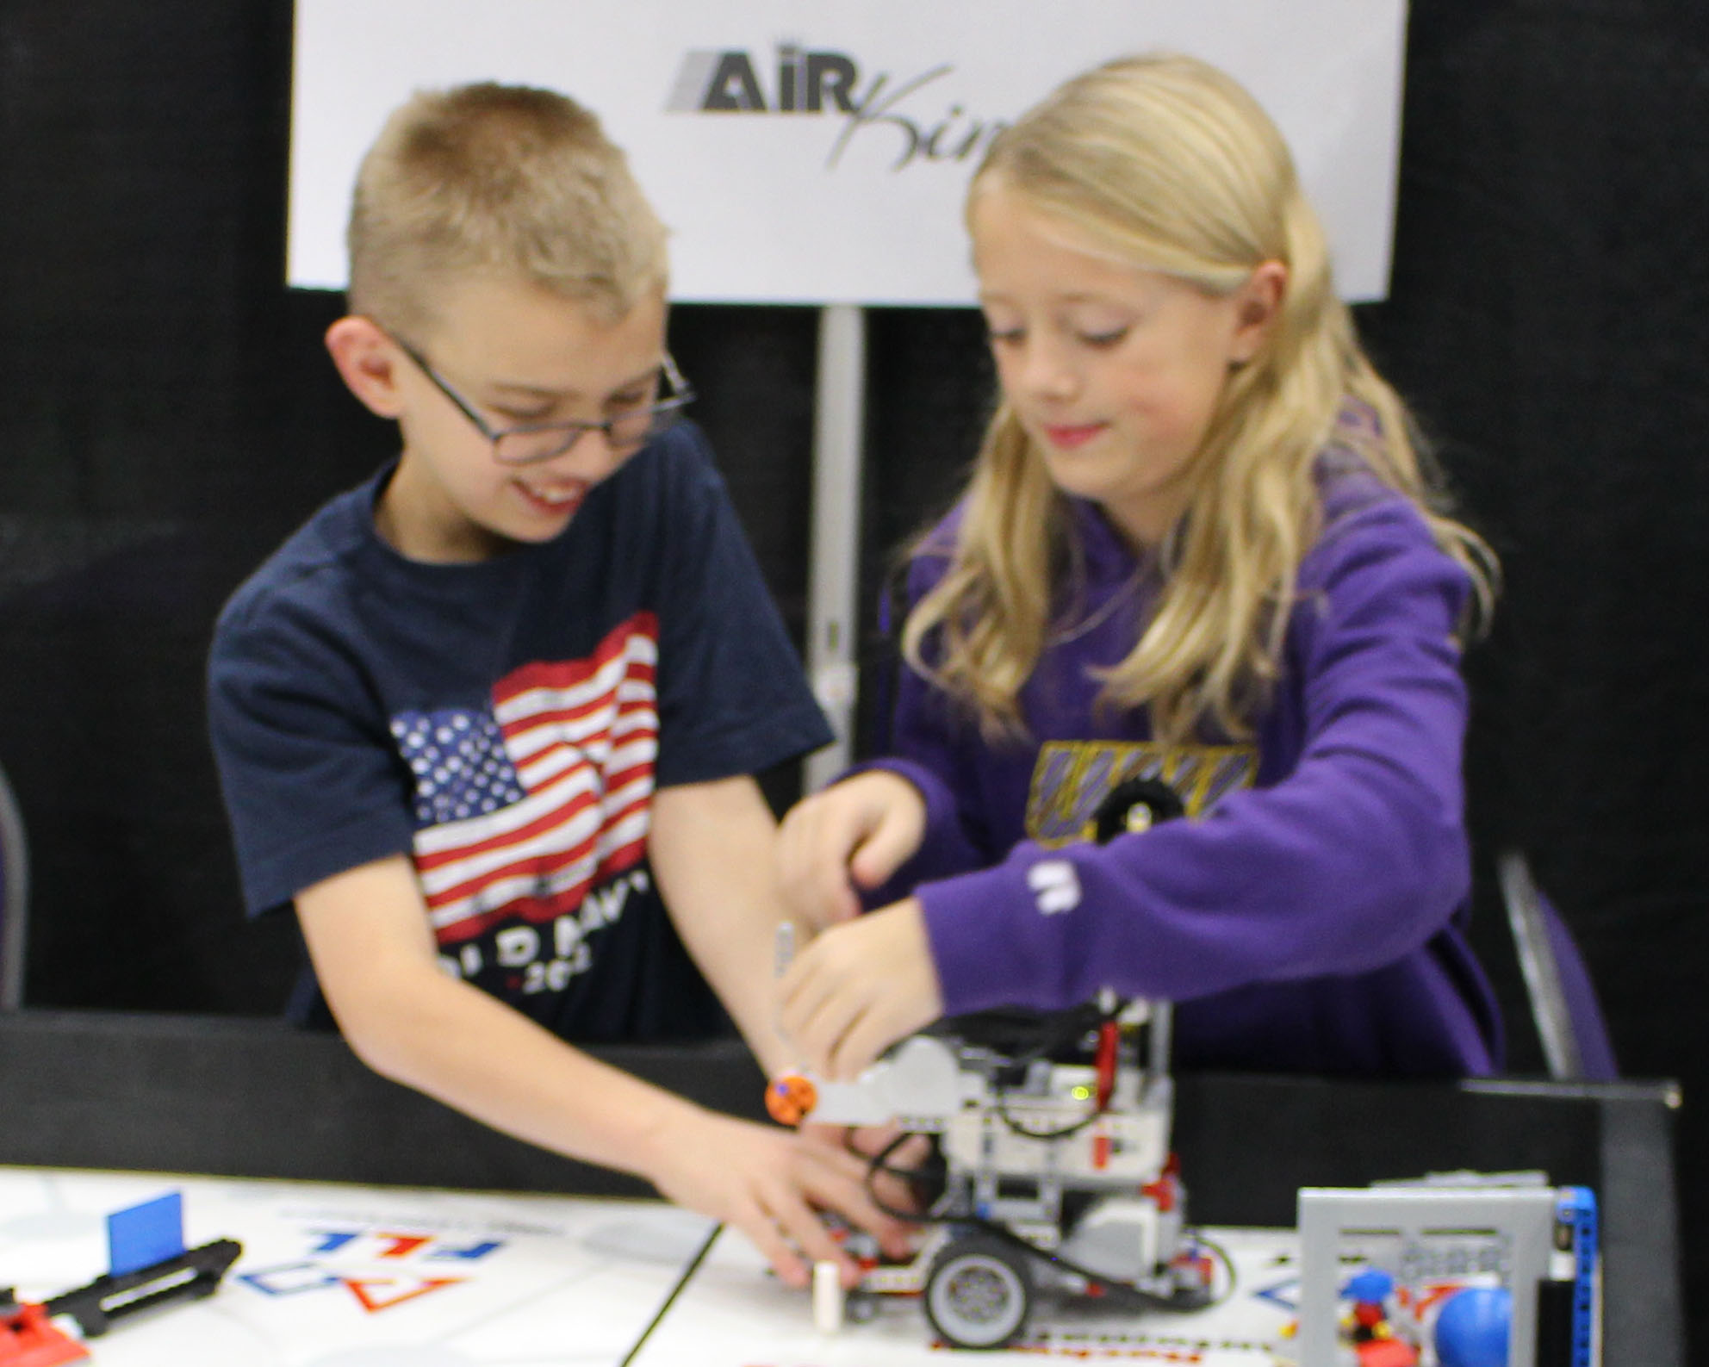
Since 2008, over $45,000 awarded

Slide 9
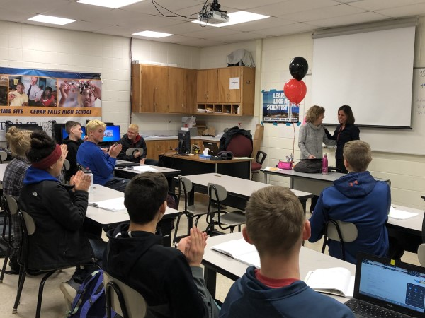
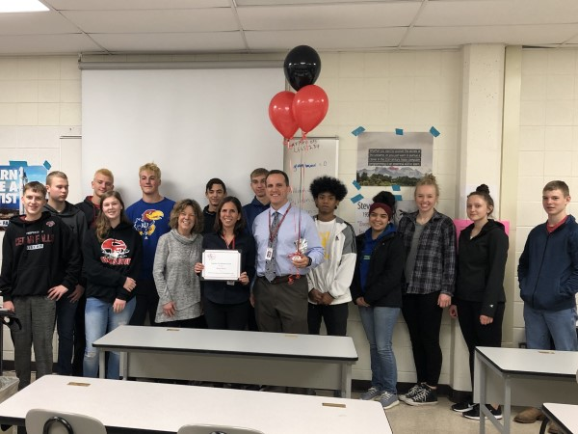
Maria perez, cedar falls high school
STEM Summer Camp Scholarships for Minorities

Slide 10
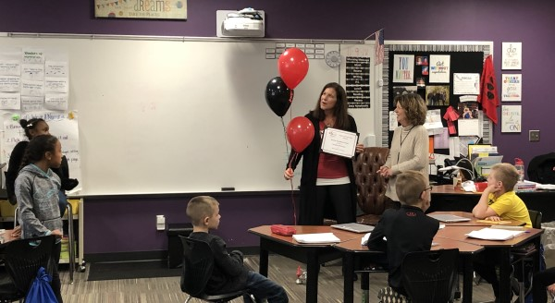
Jen mccartan, north cedar elementary
Legacy of Learning Excellence Grant
Short Reads for Great Gains in 3rd Grade

Slide 11
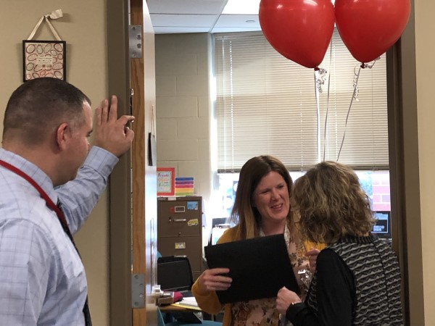
Julie rouse, holmes jr. high
School Improvement thru Tiger Talks

Slide 12
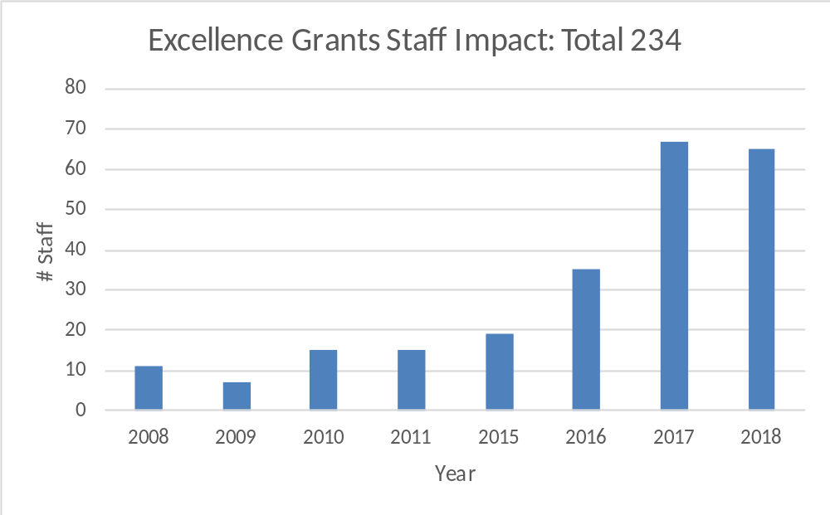
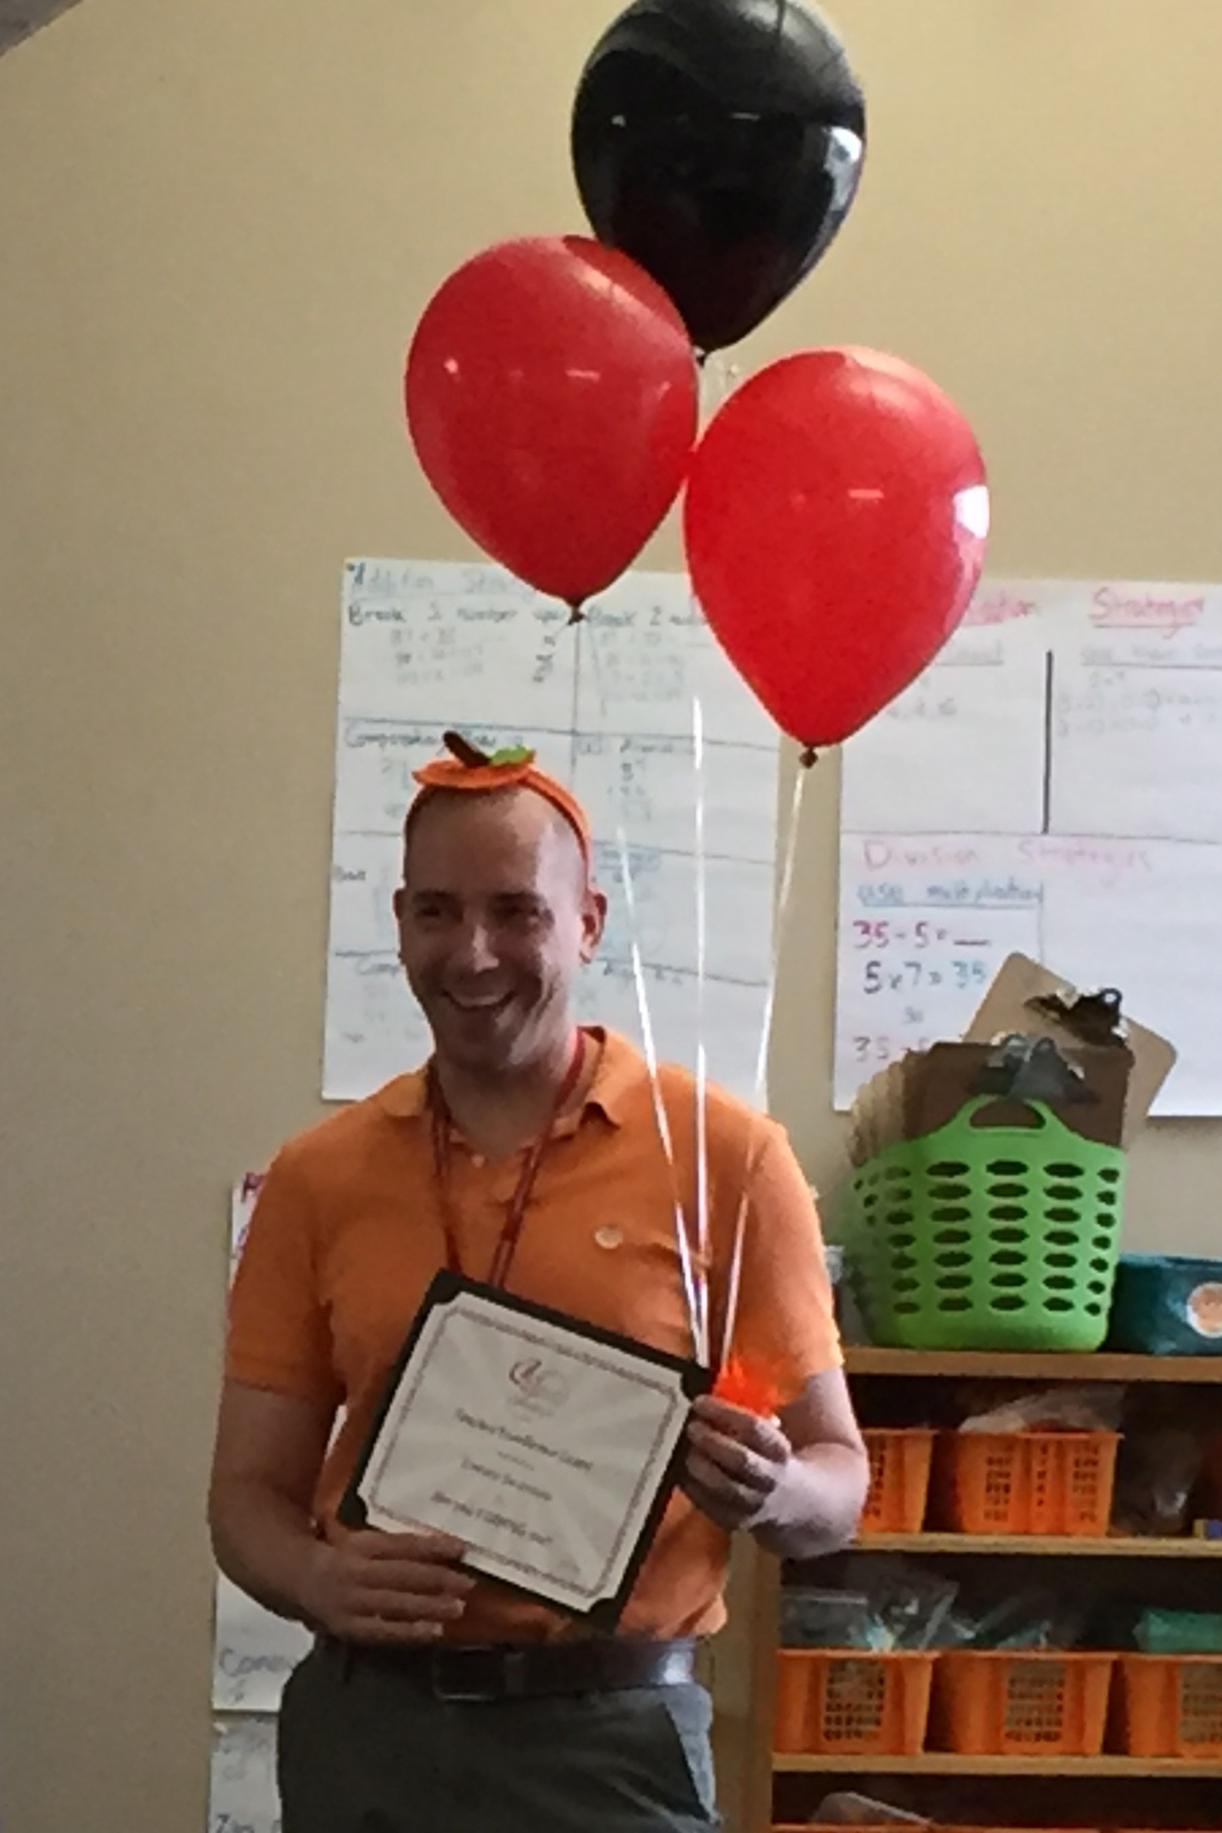
Since 2008, over 234 staff impacted

Slide 13
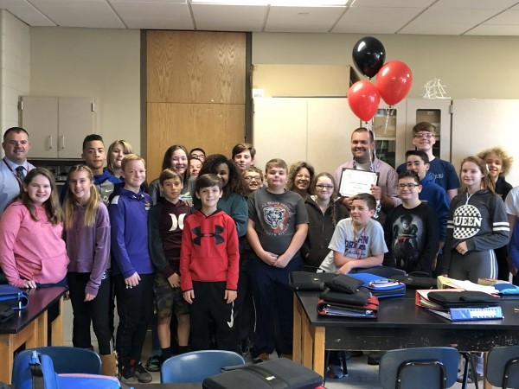
Robert welter, holmes jr. high
Tiger Pride Garden Expansion

Slide 14
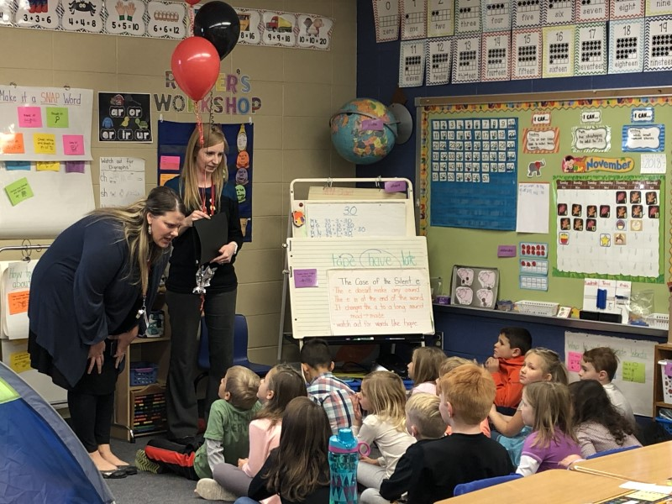
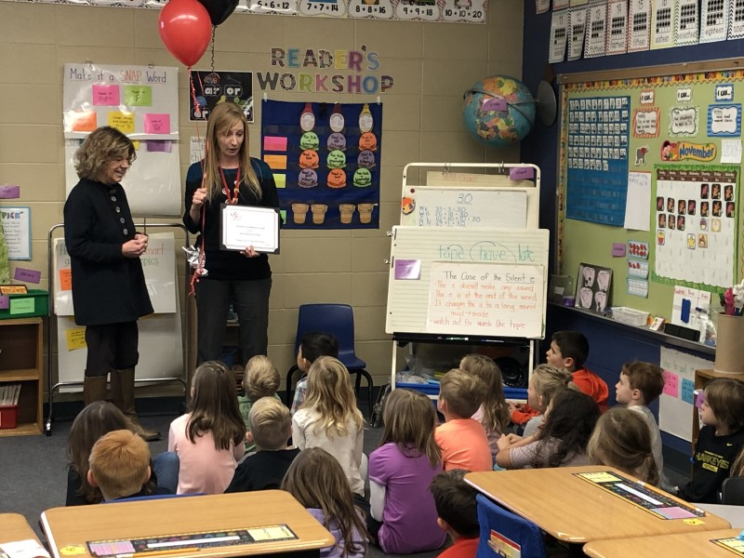
Michelle Kirchner, HaNSEN ELEMENTARY
Bringing Home the Best STEM Books in 1st Grade

Slide 15
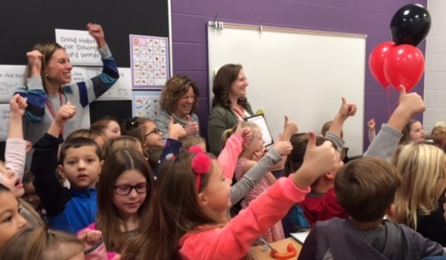
Jennifer tjaden, Aldrich elementary
Karen and Jim Bolger Memorial Excellence Grant
School-to-Home Book Connection in 1st Grade

Slide 16
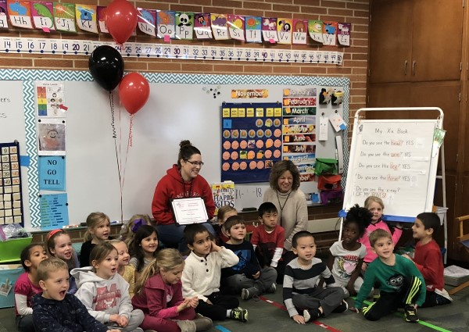
Traci Edson, orchard hill elementary
Carol Brenden Memorial Excellence Grant
OSMO Kits For Technology, Literacy and Math in Kindergarten

Slide 17


To our generous donors, Thank you for making these grants possible each year!
Supporting “every student, every day”

